Slide 1

ZARA THERA CLINIC
JOIN
OUR TEAM
Clinic Website

Slide 2
Member
01
02
03
Instructor: Le Quoc Dung
Dinh Ho Quyen Anh (Leader)
Le Duc Huy
Tran Huu Phuc
Batch:176

Slide 3
TABLE OF CONTENTS
01
02
03
04
INTRODUCTION
System analysis and design
Technical
Advantages, disadvantages, and oriented development

Slide 4
WE ARE HIRING
I. INTRODUCTION
At Zara Therapy Clinic, we help a person relieve stress, increase relaxation, improve circulation and gain relief from pain by manipulating the muscle and tissues in the body. They help rehabilitate injuries through touch and aid in the general wellness of a patient.

Slide 5
II. System analysis and design
WE ARE HIRING
At Zara Therapy Clinic, we help a person relieve stress, increase relaxation, improve circulation and gain relief from pain by manipulating the muscle and tissues in the body. They help rehabilitate injuries through touch and aid in the general wellness of a patient.

Slide 6
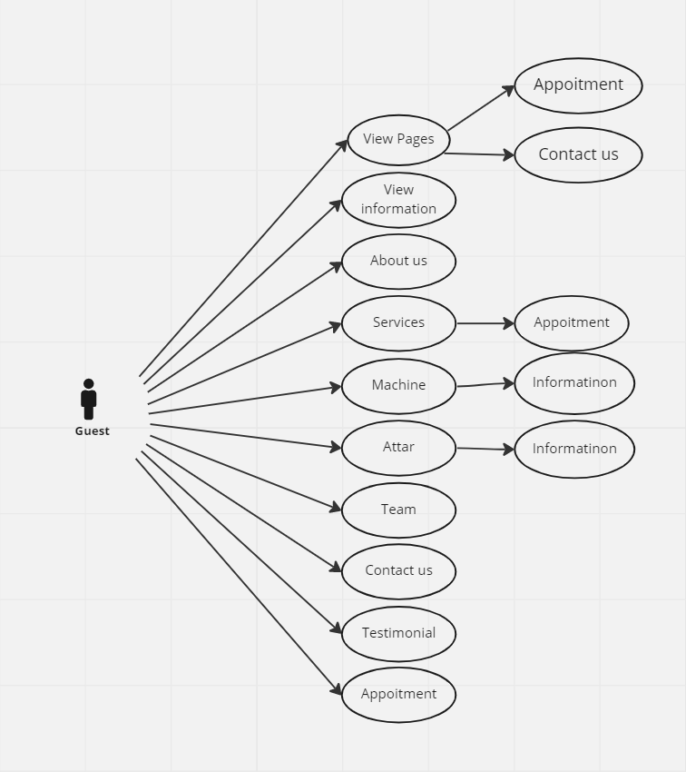
Use Case

Slide 7
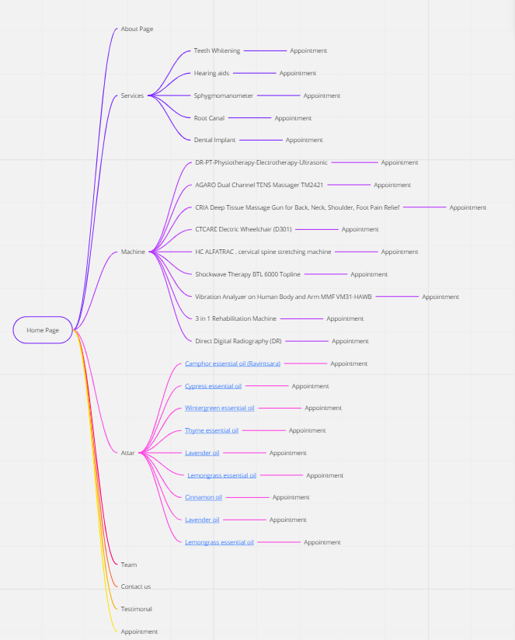
Site Map

Slide 8
01
WE ARE HIRING
System analysis and design
The Objective of this program is to give a sample project to work on real life projects. These applications help you build a larger more robust application.

Slide 9
The Web site is to be created based on the following requirements.
WE ARE HIRING

Slide 10
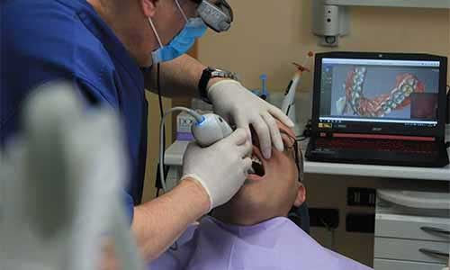
I. The Top of the Page should be presented with a suitable logo and add the images of therapies/demosessions.

Slide 11
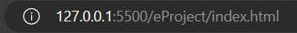
II.The site must contain the links to navigate through any category for the information.

Slide 12
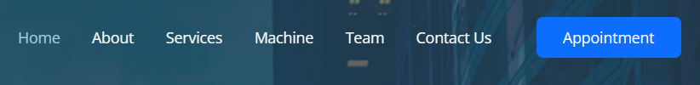
III. The site should display a menu which will contain the options for brief introduction about the various therapists available, contact details and any other information if required.

Slide 13
IV. There should be list of related products and services. The products may include essential oils, lotions and few helping machines and accessories.

Slide 14
V. Various services should be categorized as per the technique/medical aid/beauty aids etc.

Slide 15
VI. Apart from all above there should be sections like

Slide 16
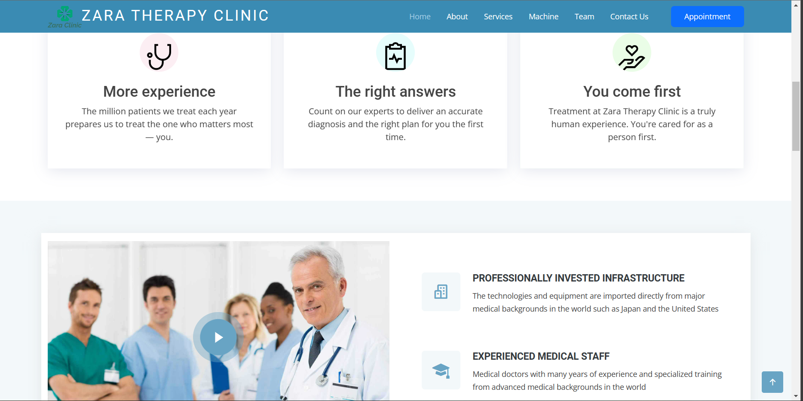
Gallery

Slide 17
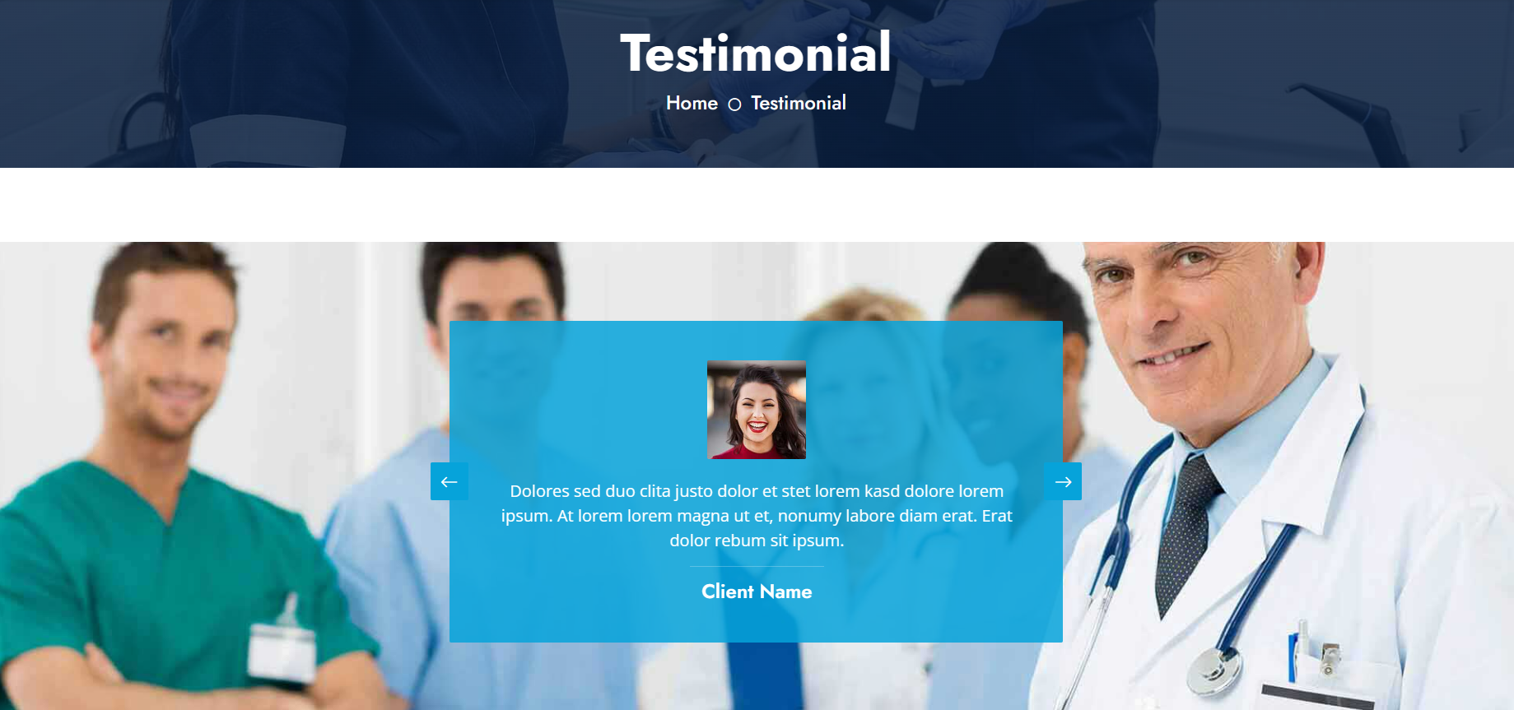
Client testimonials/Reviews

Slide 18
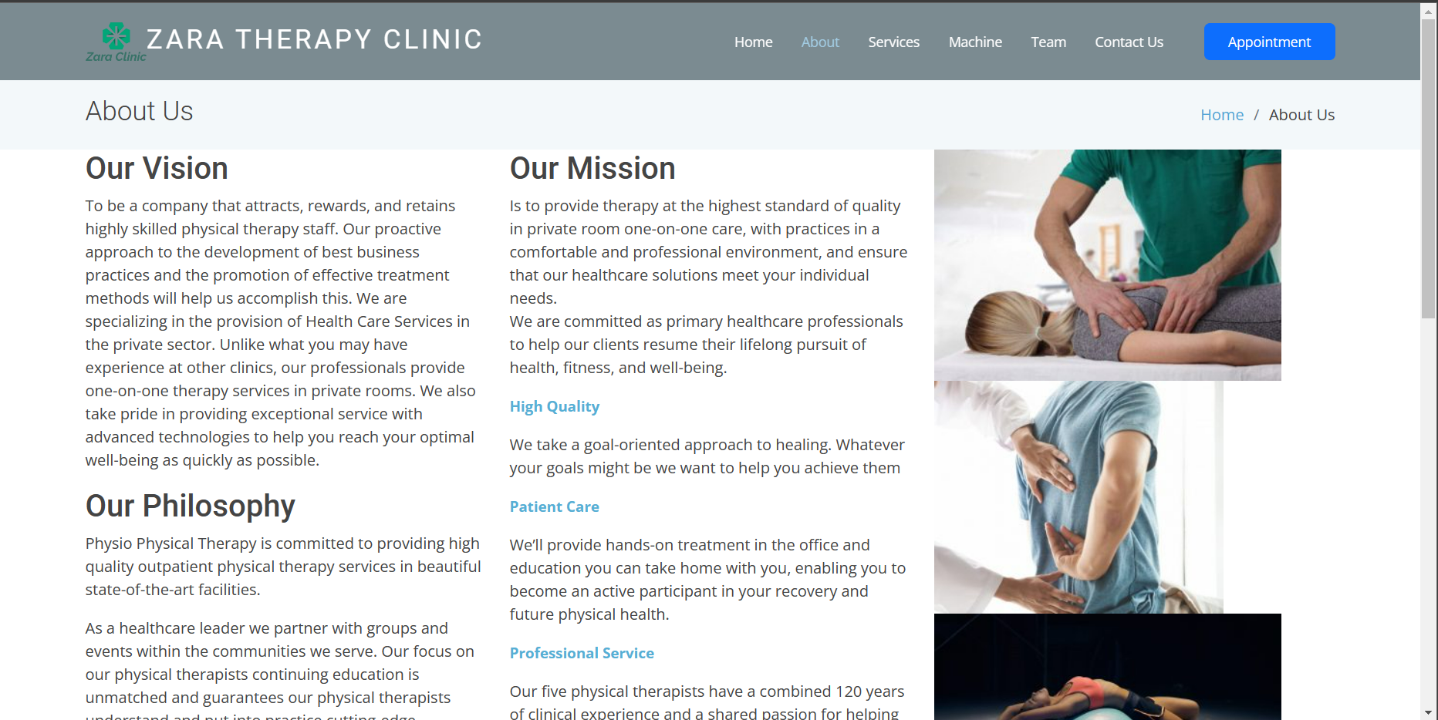
An About us section

Slide 19
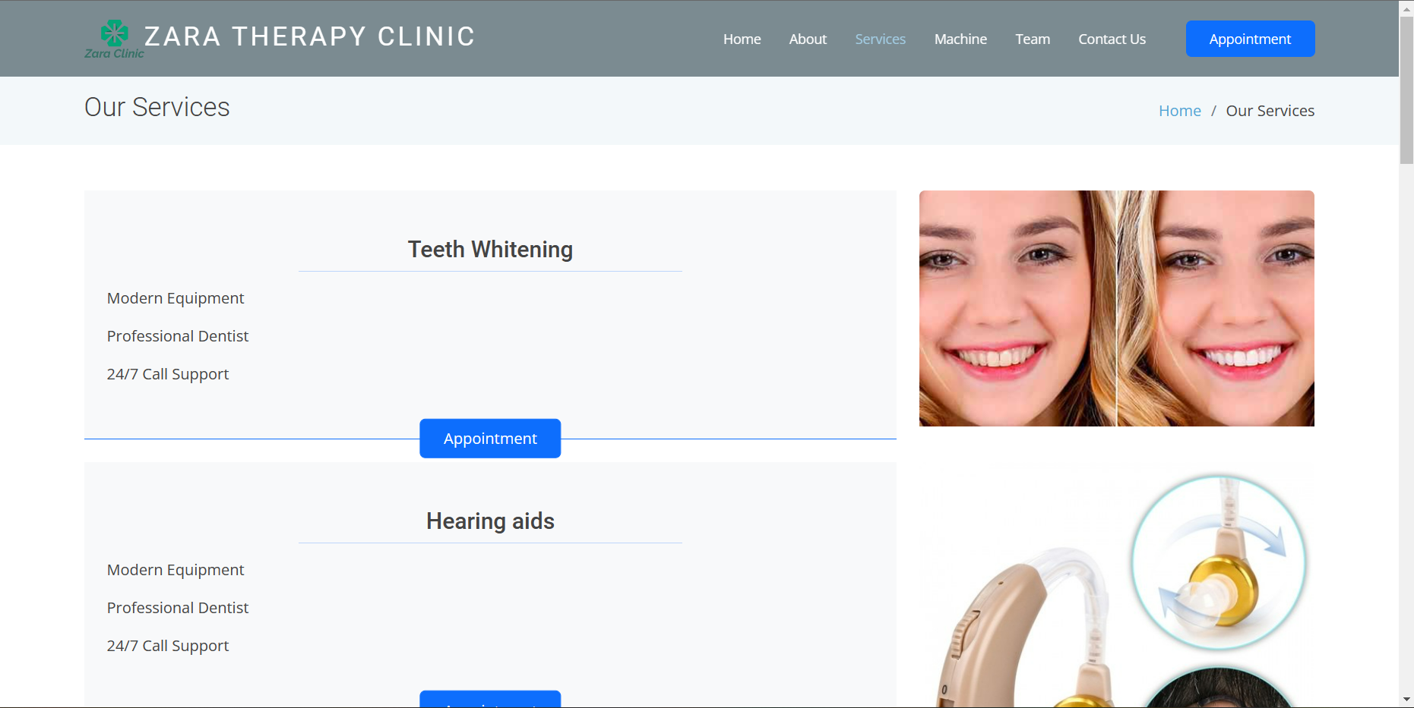
Educational Information (About Therapies)

Slide 20
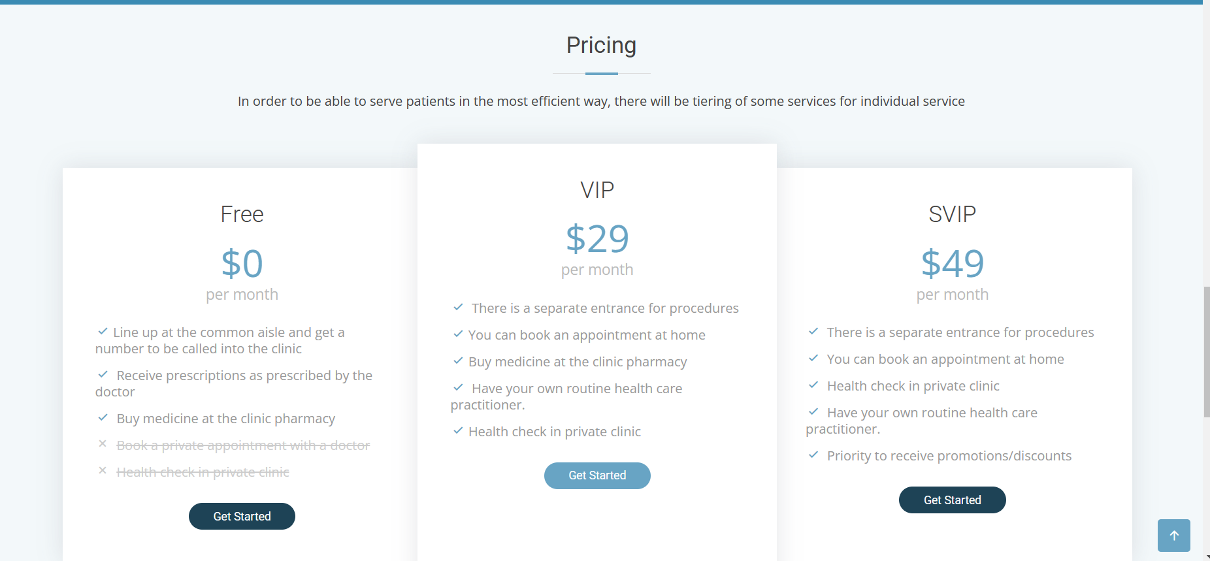
Offers and discounts

Slide 21
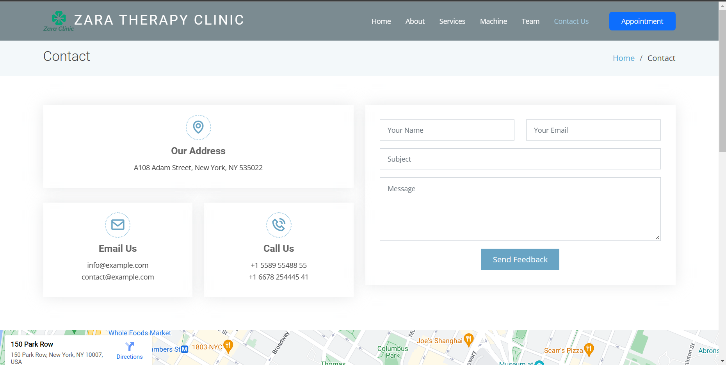
VII. Contact Us

Slide 22
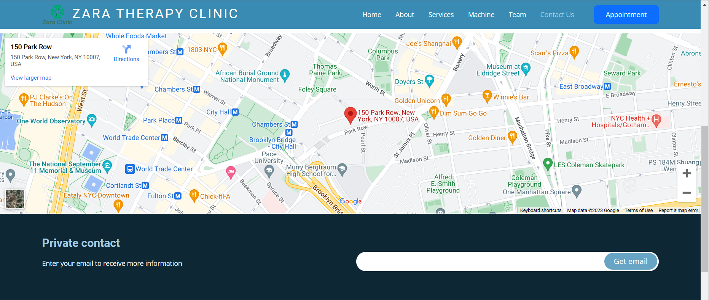
1. Address of the stylist (eg. GoogleMaps)

Slide 23

2.The email address

Slide 24
VIII. Over and above this, the portal should implement the following functionalities:

Slide 25
1. Display a continuous scrolling ticker at the bottom of the page with current date, time, and location

Slide 26
2. Display a visitor count at the top right corner of the page beside a logo image.

Slide 27
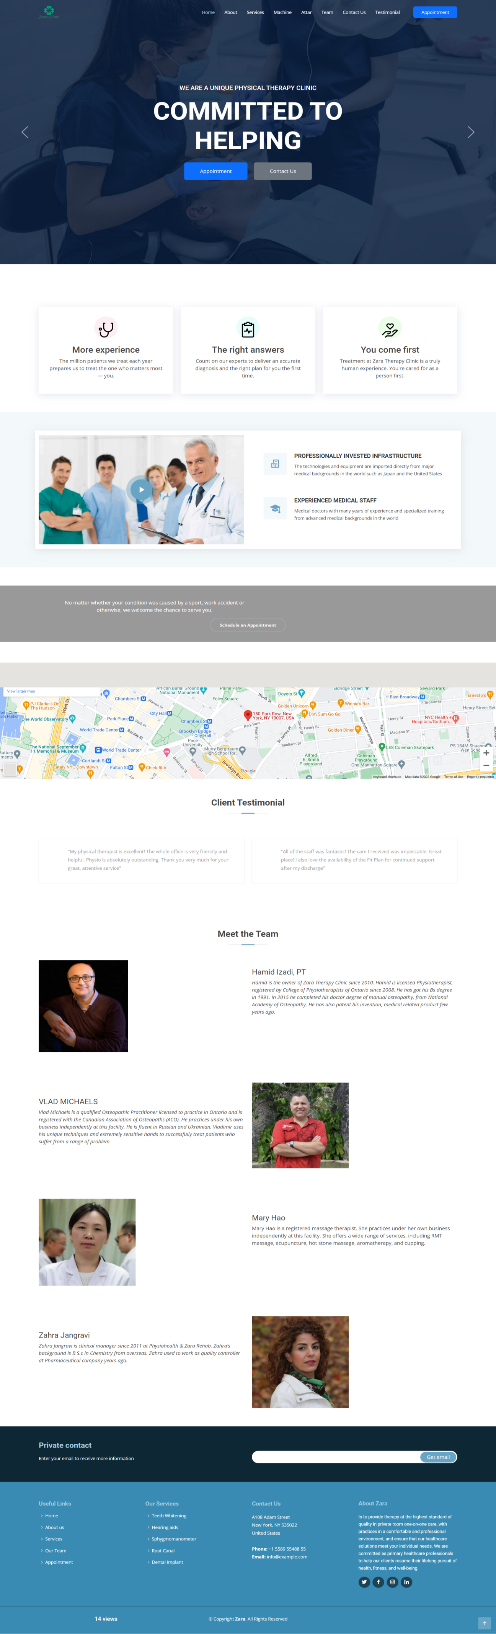
Layout Home Page

Slide 28
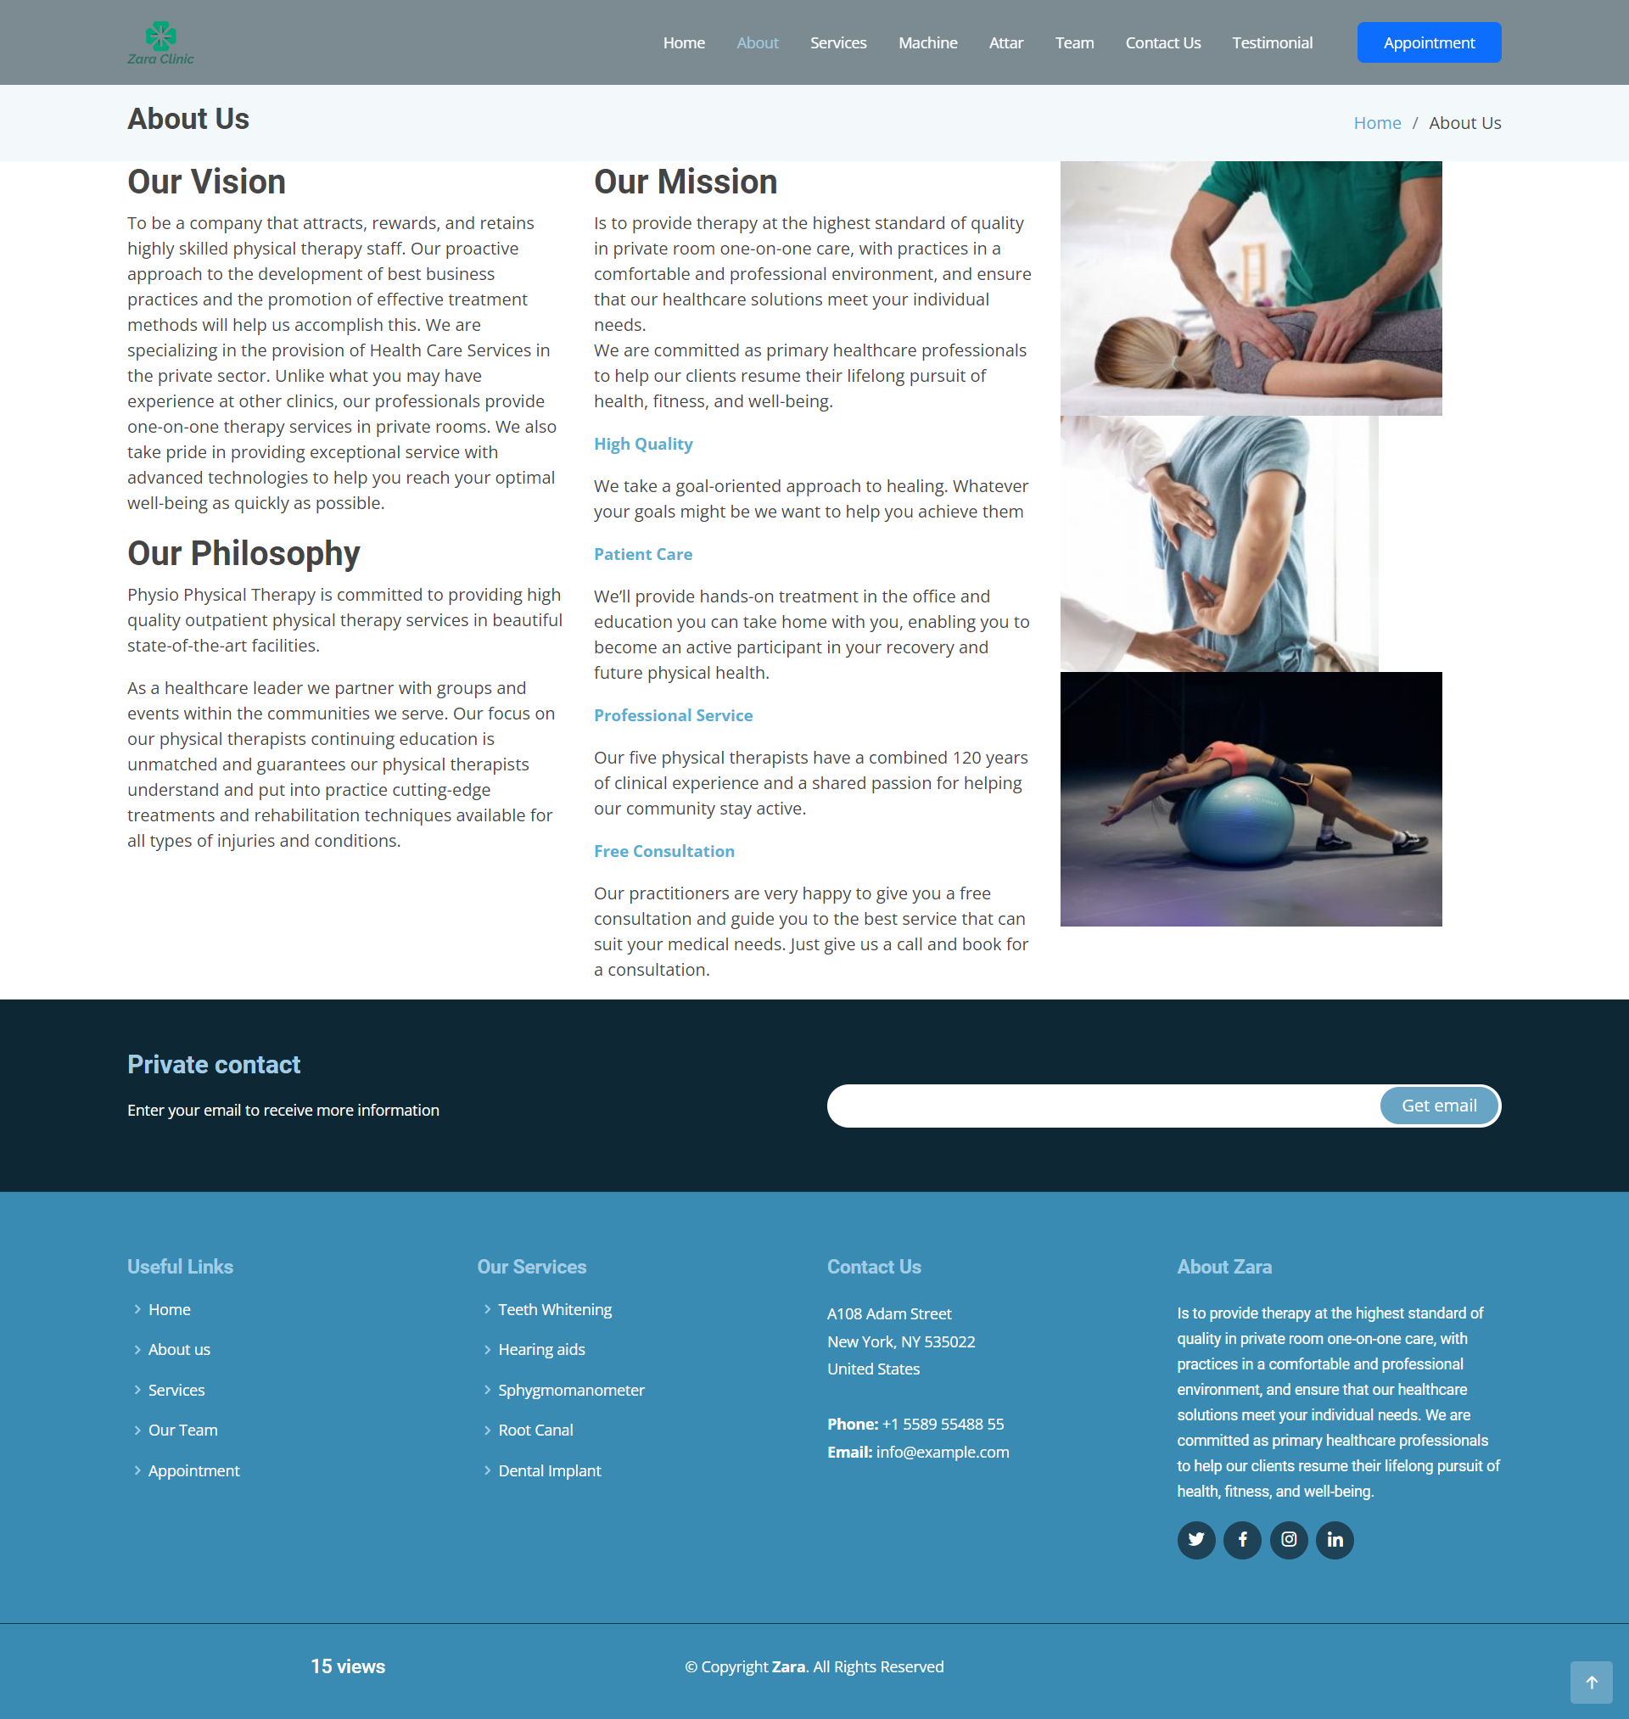
Layout About page

Slide 29
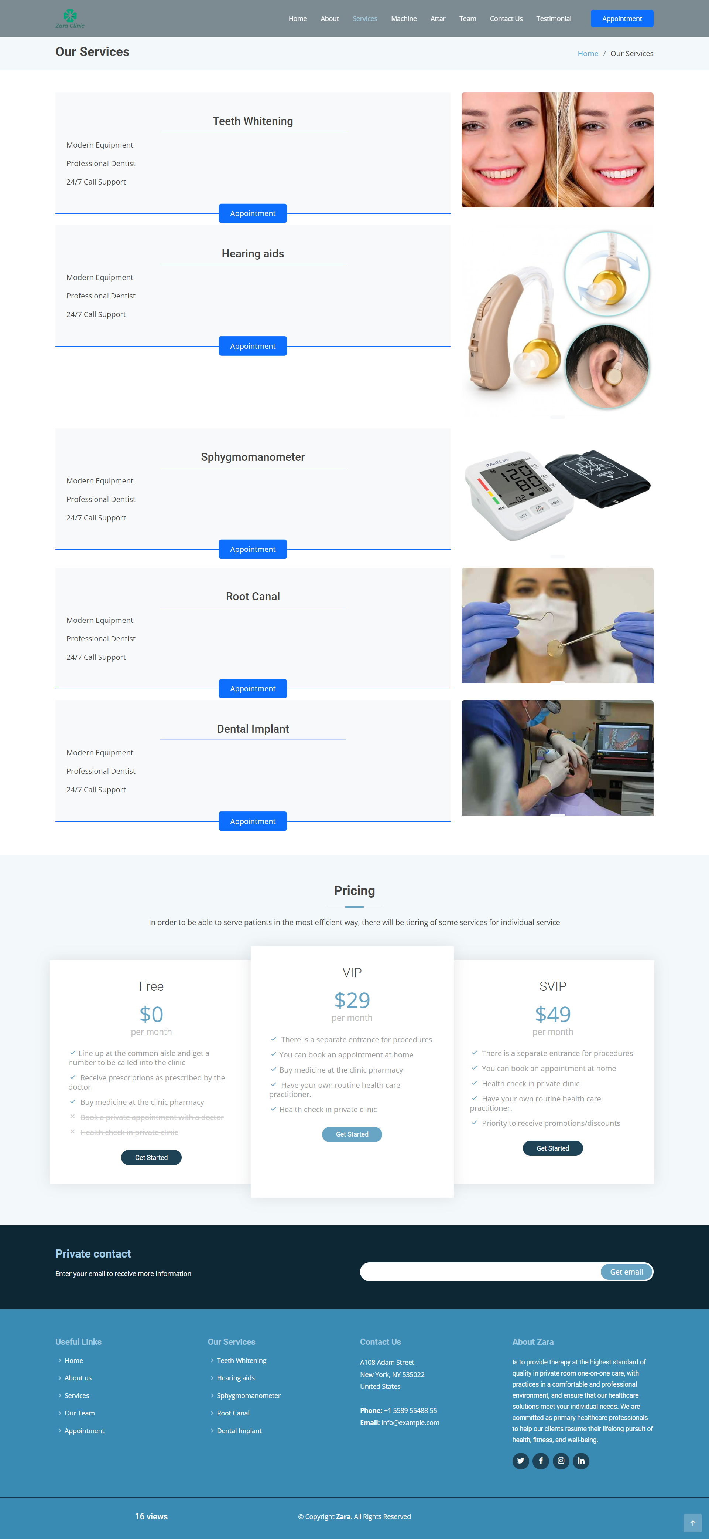
Layout Services

Slide 30
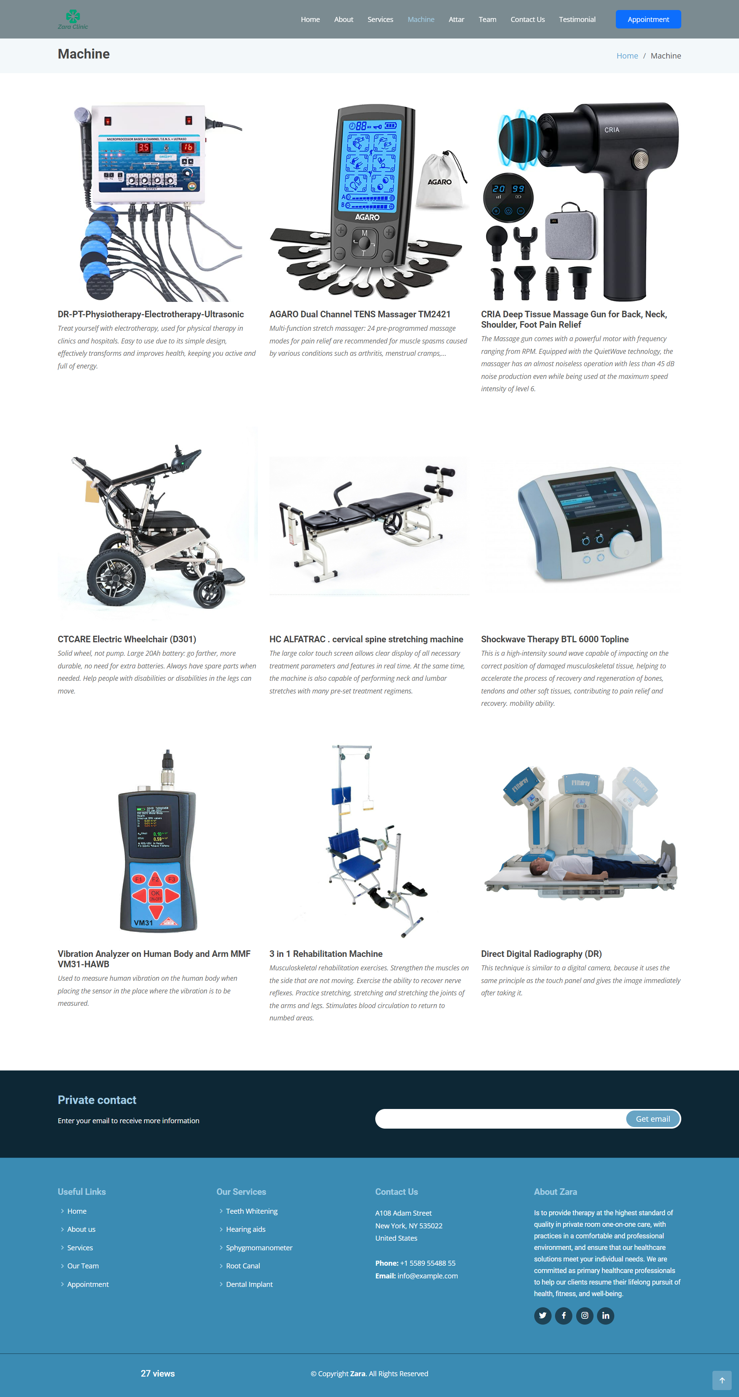
Layout Machine

Slide 31
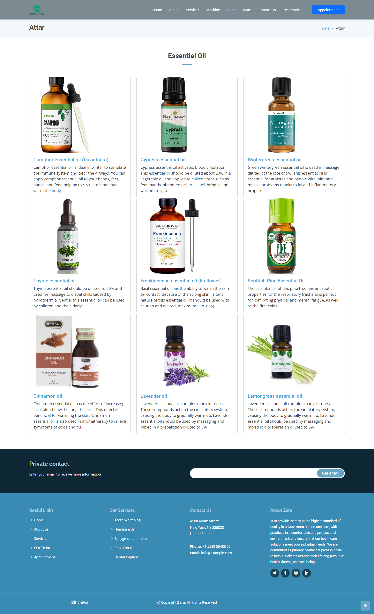
Layout Attar

Slide 32
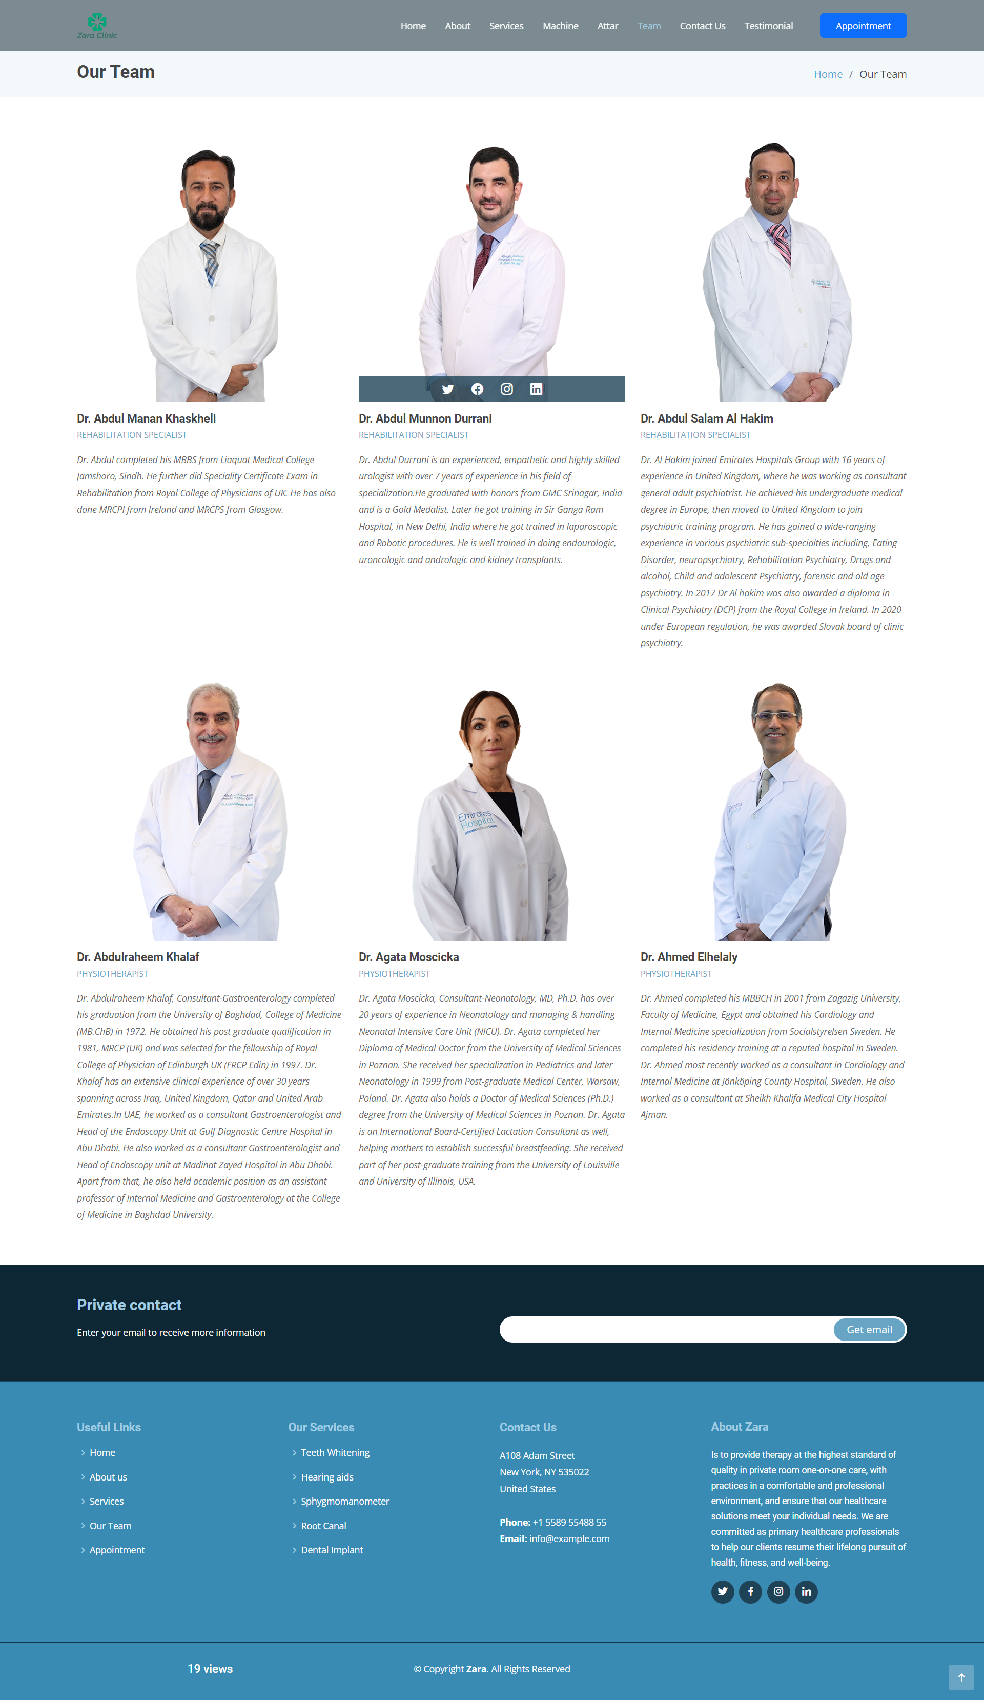
Layout Team

Slide 33
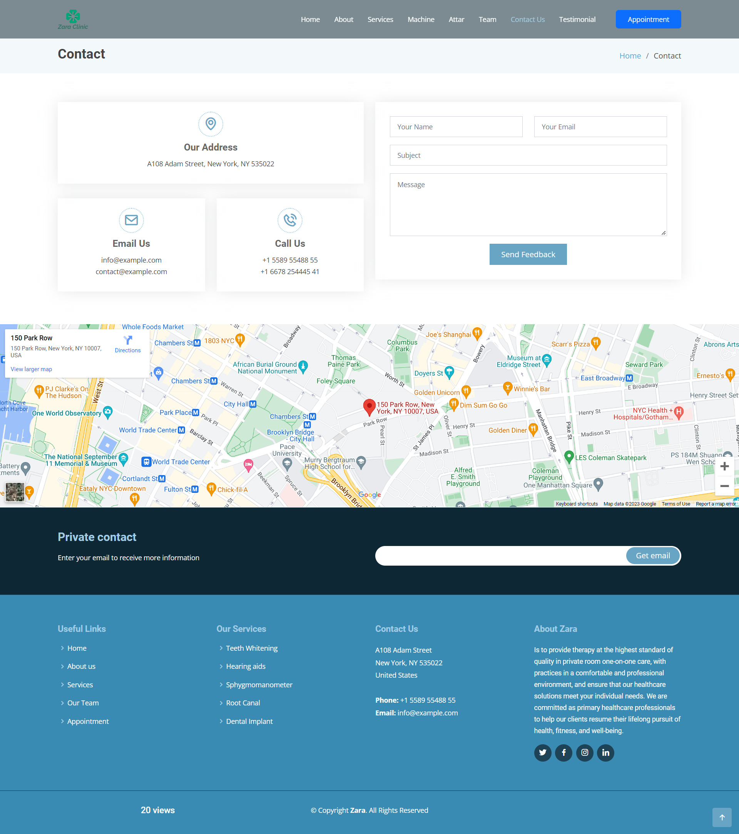
Layout Contact us

Slide 34
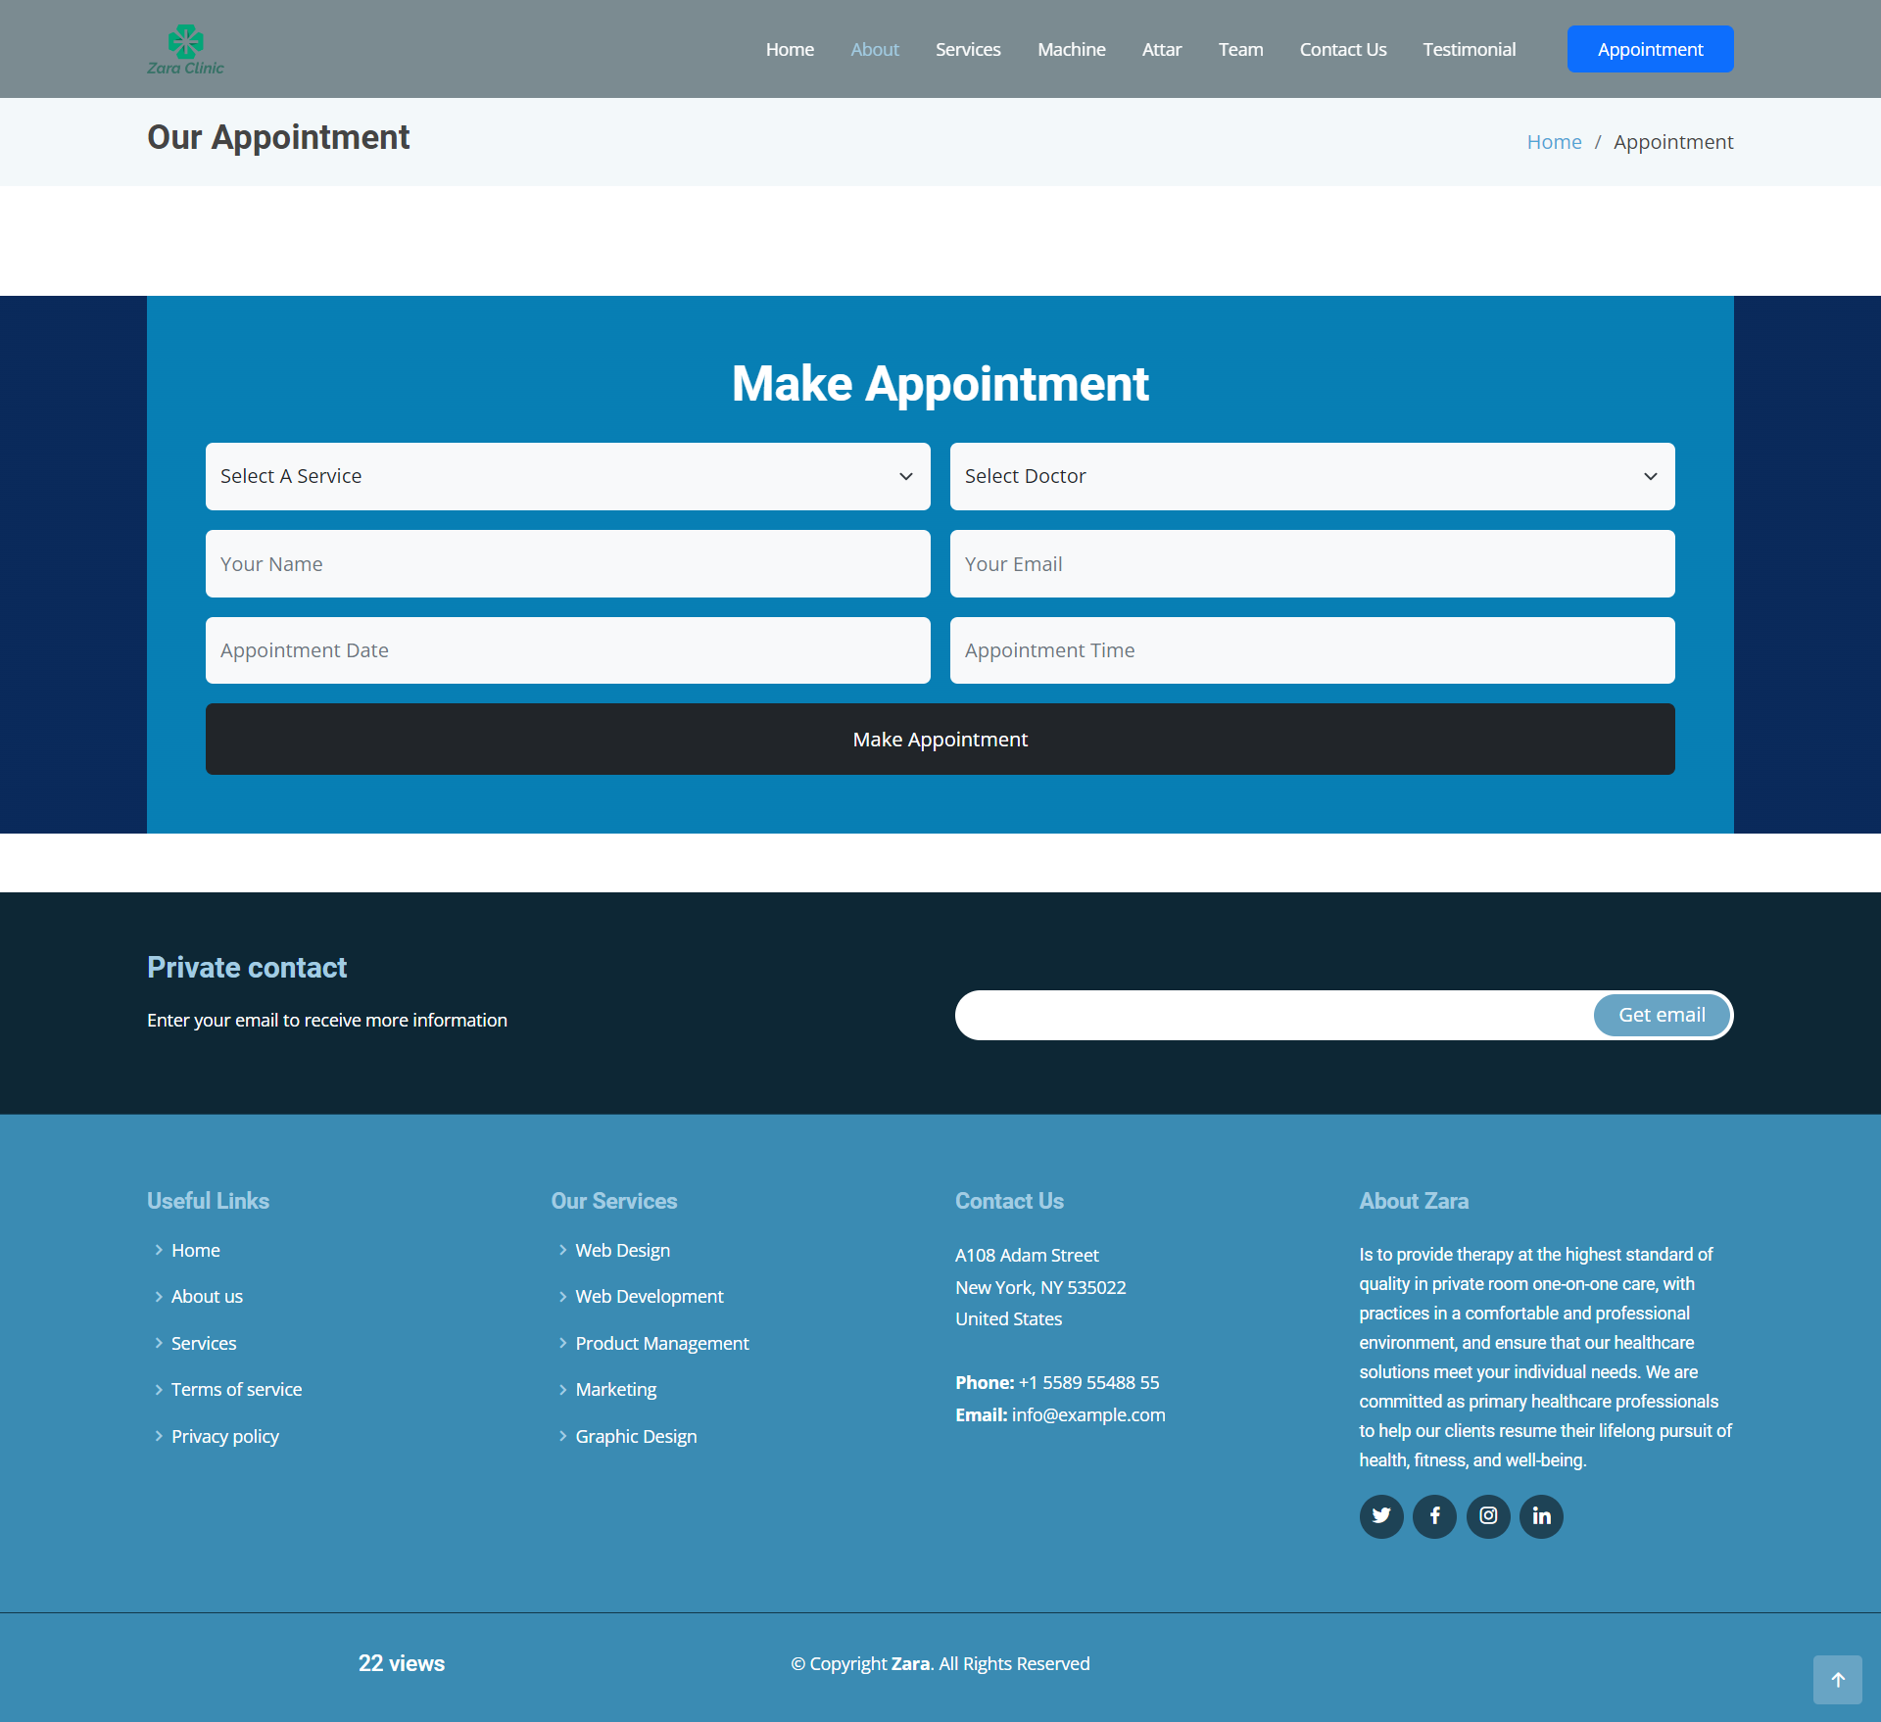
Layout Appointment

Slide 35
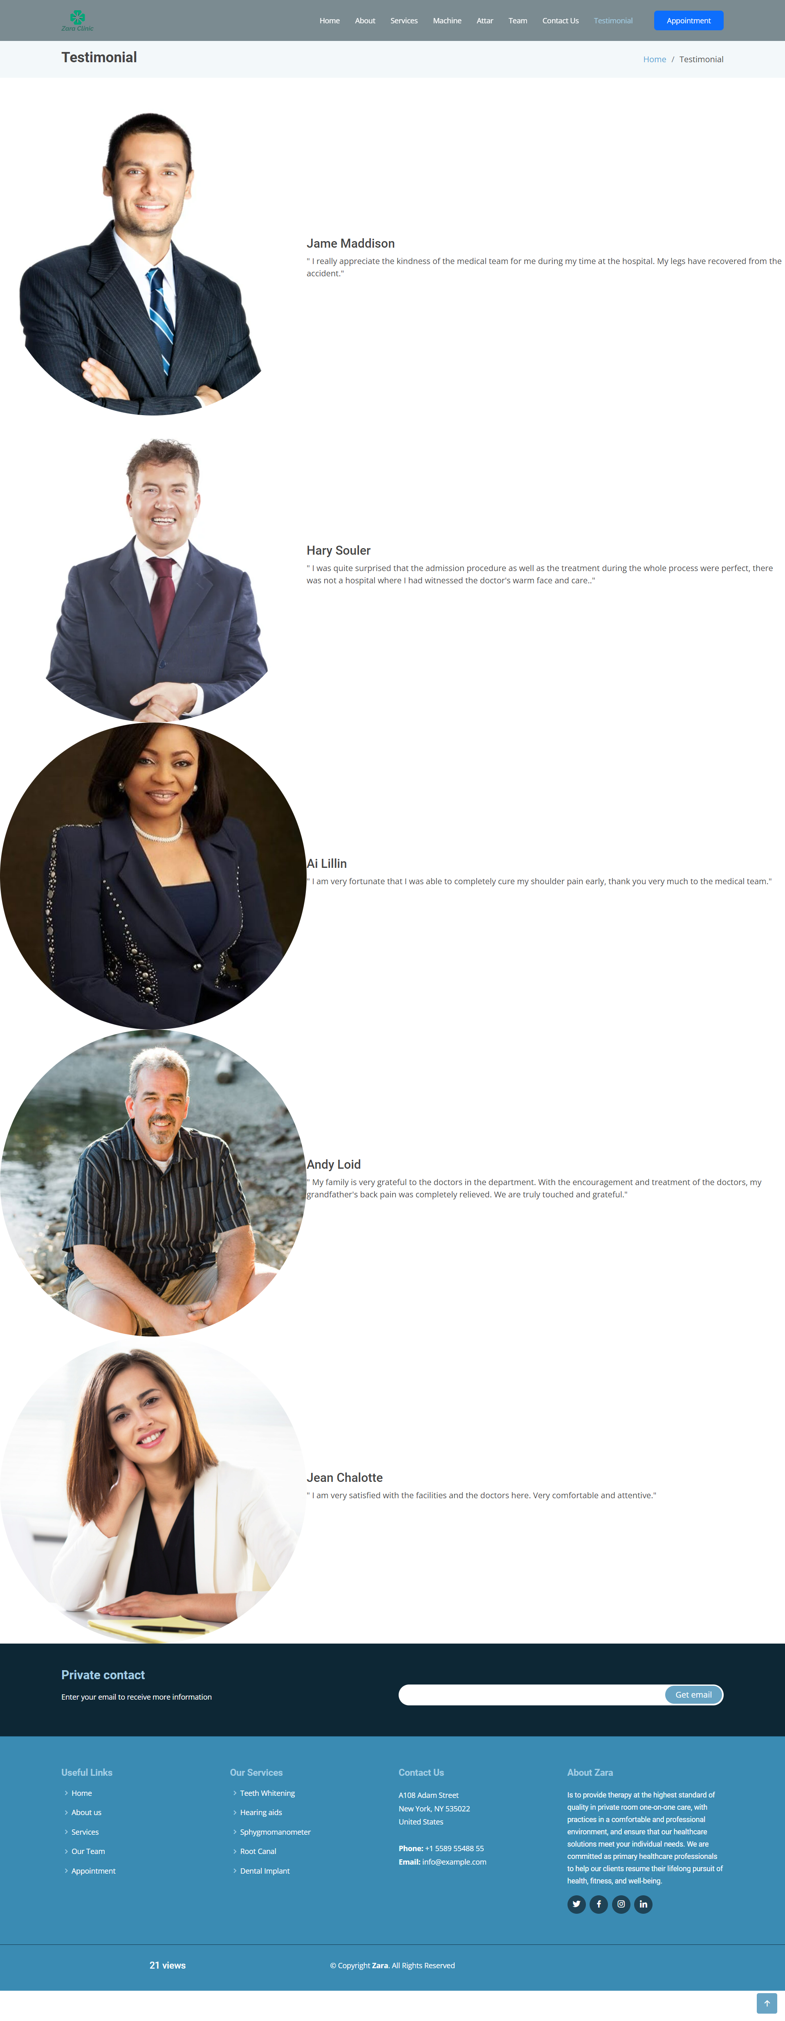
Layout Testimonial

Slide 36
III. Technical
HTML5 & CSS3.
AOS
Owl carousel
Responsive Bootstrap
Validation for bootstrap.
JQuery & JavaScript.
AJAX and JSON
Local Storage
Material for bootstrap:
Material for bootstrap:
JS popover.
JS Scrollspy.
Modal.
BootStrap Carousel.
Button.
Form.
Bootstrap Grid
…….

Slide 37
IV
WE ARE HIRING
Website

Slide 38
Home

Slide 39
About

Slide 40
Service

Slide 41
Machine

Slide 42
Attar

Slide 43
Team

Slide 44
Contact us

Slide 45
Appointment

Slide 46

THANKS FOR WATCHING
WE ARE HIRING
Please keep this slide for attribution

